Slide 1
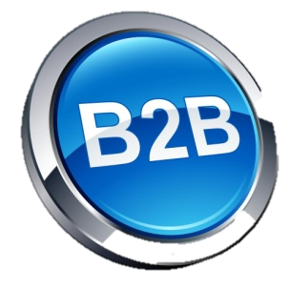
Back 2 Business
B2B is Back…StarVest never left!
Larry Bettino
January 15, 2013

Slide 2
Starvest partners overview
Established 1998; Two funds – $400 million
Technology - enabled business services (B2B)
Software-as-a-Service (SaaS)
Internet Marketing
Data/Information-based businesses
eCommerce (technology and infrastructure)
Security and Compliance
Expansion stage ($2m - $20 million revenue)
Workflow, transaction - based revenue, network effects
Invest nationwide (30% NY, 30% Silicon Valley)
“Where can we add value” – Service Provider

Slide 3
Venture B2C INVESTMENTS

Slide 5
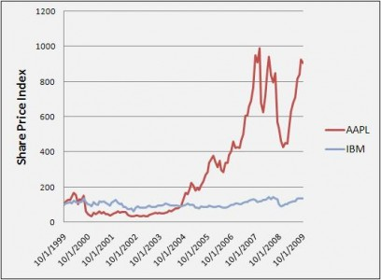

Slide 6
Attractions of B2C
Small upfront development investment
Consumers willing to try new things
Can generate many users quickly (viral)
Generate initial revenue quickly (Google Ad Exchange)
Rapid valuation increases possible!

Slide 7
B2C Valuations: pre Ipo Performance

Slide 8
Comments on B2B Investments
“Let’s face it, business to business is DEAD.” BusinessWeek, August 2011
“The Death of B2B Venture Capital” Prominent VC, October 2009
“VC’s have given up on [B2B].” Andy Bechtolsheim, Founder, Sun Microsystems WSJ May 2011

Slide 9
But…
Attracting Consumers is Unpredictable
(Read: Expensive)

Slide 10
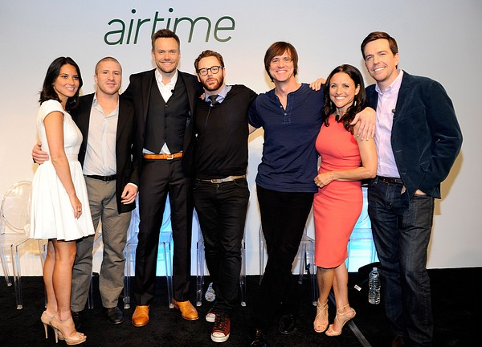

Slide 11
But…
Monetization is Hard

Slide 12
$ Generated per user
$190.00
$190.00

Slide 13
But…
Consumers are Fickle

Slide 14
Time to 1 million users
AOL
eBay
4Square
Path
OMG POP
66 months
24 months
13 months
15 days
? days

Slide 15
B2C Valuations: post Ipo Performance
$19.64
$2.48
$9.11
$4.80

Slide 16
Flavor of the Month – B2B!
“Enterprise software is the hottest thing!” Business Insider, April 2012
“Businesses are increasingly turning to startups and small companies for new technology for competitive advantage.” WSJ, August 23, 2012
YCombinator this round – 50% is B2B
“Recent survey of CIO’s: 73% say they must embrace new technology, or risk losing market share.” Harvey Nash Group

Slide 17
B2B Attractions
B2B Building is Formulaic
Buyers are economically driven (ROI)
Happy customers are sticky (low churn)
Economic model (SaaS) getting greater traction
Consumerization of B2B (big trend)
Valuations/Outcomes can be excellent, too!

Slide 18
B2B Share price Performance
$62.70
$32.00
Price as of Jan 2012 = $41.88
IPO= $17.00
$52.12
$34.31
IPO=$18.00

Slide 19
STARVEST - Experienced B2B Investors
NetSuite
iCrossing
FieldGlass
MessengerOne
Connected
Newgistics
Public Value $4 Billion+
$400m to Hearst
$212 to Madison Dearborn
$180m to DELL
$117m to IronMountain
Private; Revenue >$200m

Slide 20
Current StarVest II B2B Portfolio
Veracode
Switchfly
Xignite
RAMP
Host Analytics
NewComLink
IRON Solutions
Transactis
PrecisionDemand
The Receivables Exchange

