Slide 1
A Recovering Entrepreneur’s Lessons in Raising Angel Money
Cristian A. Ossa
Screening Committee Chair
Delaware Crossing Investor Group
http://www.delawarecrossing.org/
732.735.4908

Slide 2
Background
MBA, 1991 University of Massachusetts
Consulting firm through 1996
Giftcertificates.com (retail)
raised over $100mil
400+ employees
made very little for me (no great exit)
eRateRequest.com (Shipping)
raised over $8mil (single raise)
20 employees
‘reasonable’ exit; sold to Descarts Sys.
Notes:
Background is important to know where an Angel comes from; what they know and where they can help the most.
Also, what MAKES THEM an Angel.

Slide 3
Background
LABS (Live Audience Business Solutions)
raised over $3mil (many raises)
exit; sold to SMARTDM
Rosetta Technology Group
founder and partner
consulting business solutions
application development (web/desktop)

Slide 4
Background – NOW…
Angel Investor, Consultant & Mentor
Mentor at TechLaunch (Accelerator) and others
Delaware Crossing Investor Group
Screening Committee Chair
Several $ investments, all tech, no exits (yet!)
+ some equity for time
Cross invest with other groups (very common)
Notes:
I moved from being an entrepreneur to an investor (either equity or $).
Many come from Wall Street, family money, big business, corp executives, etc.

Slide 5
This is the GREATEST TIME EVER
Best time (ever-ever) to raise money
How you ‘used to’ get $ ….
Lack of organization giving & seeking $ Now; several things have come together…
Notes:
You have perfect timing!
Lawyer and Accountant … not much more.
Now there is organization around getting your check, as well as for those writing the check.

Slide 6
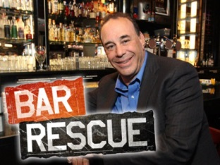
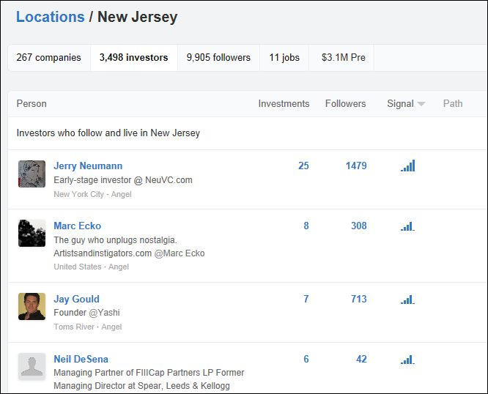
This is the GREATEST TIME EVER
Kickstarter
Indiegogo
…
Richs guys starting their own Shark Tank for fun & profit
www.Gust.com
Mo’ Money
Right now, Philadelphia and New York are showing high growth rates among High Net Worth Individuals – those people with at least $1 million in investable assets — but one study says the future is looking pretty bright for New Jersey….
Angel List
Organized GROUPs
of Angels
Accelerators
Incubators
Organizational Aid
(VANJ) etc…
Notes:
Rich guy example -> Tom Lasorda Chrysler CEO, Start vc fund like Shark Tank, except we all like each other. (MAY 2013)
More millionaires than ever before (Jersey ranks 1 or 2 depending on where you read/believe)
Angels are no longer independent (WORK IN GROUPS), TALK to eachother.
You talk to 3 groups, you’ve touched close to 150 – 200 angels.
Organizations to help you..
Internet -> get lists of Angels, Groups, types, read everything you need to know…

Slide 7
This is the GREATEST TIME EVER
What does this mean … so what ?!
TIME IS NOW to get MONEY.
PLAN, PREPARE, READ, ATTEND
… AND YOU WILL GET YOUR MONEY.

Slide 8
… Now the “Do”s
Learned from both raising
And
Investing angel/venture money

Slide 9
DO ! (top 10 DOs to get the check)
Know where you are in the process

Slide 10
Know the process..
Due Diligence
Pitch
(10-15 min)
10 deck
Elevator +
(2-3 min)
Elevator (30 sec)

Slide 11
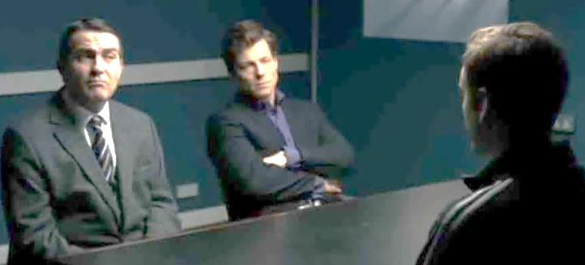
DO !
Know where you are in the process
Remember that everything counts
Organize your deck / narrative carefully
Problem -> Solution -> Money -> Market -> Team
ABC – Always Be (ex)‘Cited (for money)
Your homework (a disadvantage of the internet)

Slide 12
DO !
Money, Money, Money (for everyone!)
Have a board / board of advisers (real one)
Practice “inception” idea (walk away / memorable)
Know by heart THEN speak from heart & Educate yourself, hire experts, then do it yourself
Think through NON-funding options (Angels like this)

Slide 13
… And the “Don’t”s
Learned from both raising
And
Investing angel/venture money

Slide 14
DON’T
Pitch your hobby
Use tech terms, confuse, or one-up audience
Think you will get extra time
Forget Angel investing is always a bit personal (like a job or dating)
Take everyone’s advice and forget who you are, how you started, and how you got here
Overlook … WE ARE BUYING what you are selling
Underestimate the value of a “Deal” (HUGE validation) -> Smart $, credibility, etc…

Slide 15
Delaware Crossing Investor Group
40+ active and accredited members (work with other groups)
All applications in GUST reviewed, LOCAL and tech sector preferred (build once, sell many), B2B, (personal contacts)
Biggest complaint (of DCIG & ALL Angels)
SC (me and others) first reviews application
Very quick, cursory review (30-40 companies)
Asked to (phone) present to SC (7-10 companies)
If pass -> present to group (groups sees 2/month)
(Almost) always due diligence on presenters
8/10 invest.
Like MOST Venture and Angel groups -> min feedback (but ask!)

Slide 16
A Recovering Entrepreneur’s Lessons in Raising Angel Money
Cristian A. Ossa
Screening Committee Chair
Delaware Crossing Investor Group
http://www.delawarecrossing.org/
732.735.4908

