Slide 1
Eight Keys to “Yes”
Gil Beyda,
Founder & Managing Partner, Genacast Ventures

Slide 2
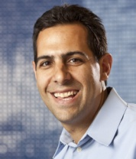
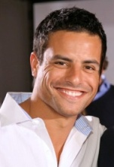
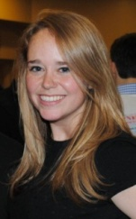
Genacast Ventures
Team
Profile
Portfolio
Co-Investors
Gil Beyda,
Founder &
Managing
Partner
David
Horowitz,
Partner
Dan Ruch,
Entrepreneur in Residence
Edy Wilson,
Associate
Deals: 4-6 per year
Stage: Seed
Non-strategic
Size: Up to $1M
Geo: Northeast US
Lead/Co-Lead
Sectors…
* B2B
* Digital Media
* eCommerce
* IT
* Mobile
* SAAS
* Video
Digital Media
(acq google)
(acq adobe)
eCommerce
Mobile
Big Data

Slide 3
1. The Problem
What problem you are solving?
Is it felt by many?
...market size
Is it well understood?
...market education
Is it painful?
…sales cycle

Slide 4
2. The Solution
How are you solving the problem?
Technology, services, processes, secret sauce, IP
How is the problem being solved today?
Alternatives & substitutes
Why is the market ready now?

Slide 5
3. The Team
Can this team create/execute the vision?
Do they understand the problem/space?
Can they lead / inspire / hire?
Are they start-up ready?

Slide 6
4. The Competition
What is your competitive advantage?
Unlevel the playing field, unfair advantage, cheat
Is your solution unique and defensible?
Copy-cats, fast followers
Who do you compete with?
Direct, indirect, nearby companies
How does the landscape change after you launch?!

Slide 7
5. The Market
Who are the players?
Market
Customers (decision-makers)
Partners
Distributors
How do you acquire customers?
How much does a customer cost?

Slide 8
6. The Financials
How do you make money?
How do revenues & expenses scale?
How much cash do you need?
How much runway do you have?

Slide 9
7. The Next Investor
What does the next investor need to see?
What do you need to de-risk?
Technology, team, market, customers, revenue
Key assumptions to prove?
Customer acquisition costs, pricing, timing

Slide 10
8. The Exit
Who will acquire your company?
Strategics, partners, customers, competitors
Why?
Technology, team, revenue, customers
When?
Early, mature, threat, partner

Slide 11
Eight Keys to “Yes”
Gil Beyda gil+vanj@genacast.com
Problem
Competition
Team
Exit
Next Investor
Financials
Market
Solution

