Slide 1
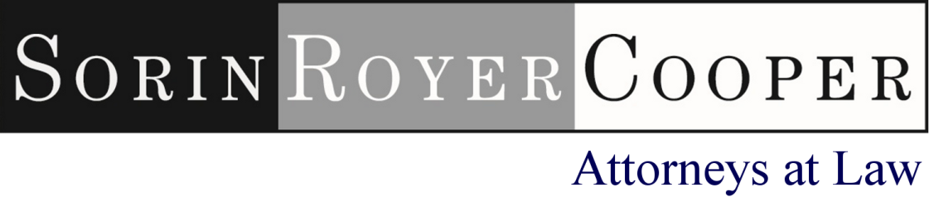
Protecting Entrepreneurs' Crown Jewels - Trademarks, Branding, and Goodwill
Presented By:
Susan Goldsmith

Slide 2

Trademark Joke

Slide 3
No Respect
Research for The Global Trademark Benchmarking Survey, conducted by World Trademark Reporter and the IP Solutions business of Thomson Reuters, was conducted earlier in 2012. The survey form was sent to leading trademark practitioners across the world, both in-house and in private practice.
In 2011 16.3% of in-house respondents stated that, across their entire organization, awareness of the importance and value of the company's trademarks was low. In 2012 17.5% said this. Respondents boasting high corporate awareness dropped by more than 12% (to 23.8%).

Slide 4
Four Main Types of Intellectual Property
Patents
Copyrights
Trade Secrets
Trademarks

Slide 5
Examples of Intellectual Property
An unnamed product (invention)
A brand name
An advertisement
A secret recipe
Customer list and customer info
Pattern on athletic shoe sole
Software code
Media content, books, songs, fabric designs

Slide 6
Types of Property – Evolution of Law
LAND = Real property = real estate
Stuff you can move = personal property
Things you create = intellectual property

Slide 7

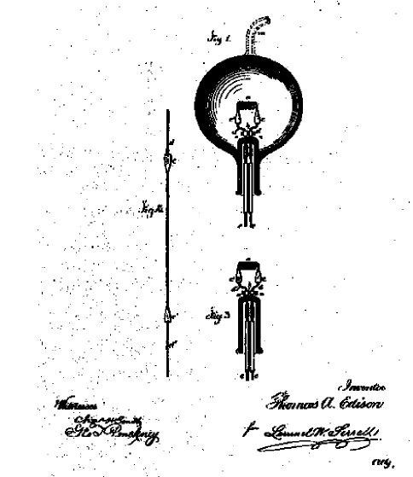

Slide 8
What is Patentable?
A new way to do something, or the new item itself
Must be new, useful, and not obvious to someone who knows about that field
The patent protects the idea
Few valid patents are broadly drafted or granted; little truly new under the sun
Design patent protection for ornamental features

Slide 9
Good Things About Patents
Lasts up to 20 years from filing date
Gives the inventor the opportunity to produce and market the invention, or license others to do so, and to make a profit
Investors want to see patents pending (at least)

Slide 10
Bad Things About Patents
Strict rules about getting one
They are expensive to get
They are expensive to enforce
You must teach others to do what you have done, even if patent doesn’t issue
You must not disclose the invention to the public prior to filing the application

Slide 11
Copyrights
The right to control copying, control variations
Given to person who creates a work in tangible form
Watch ownership – often not who you think it is
Covers expression of an idea, not the idea itself
Long term of protection (70/95/120 years)
Rights can be sliced and diced
Does not include useful objects like clothing (yet)
Must register prior to suing in US

Slide 12



Trade Secrets
Special way of doing things or special knowledge that gives business unique edge over competitors – often a recipe or way to do something
Lost if reverse engineered
Must be SECRET
Not shown to anyone (without NDA)

Slide 13

Function of Trademarks
Monetizing your idea
Not what it is but WHO it is
BRANDING is the name you give your invention, the way you sell you work, the secret sauce… the sizzle that sells your steak
Your rights against others (or theirs against you) are based on market penetration – how well the mark is known in the marketplace

Slide 14
Discussion Topics for Today
Picking and Choosing: Strength of marks
Company or division names
Product names
Domain names: buying and selling, what is cybersquatting and what to do about it
Protecting yourself
Watching others

Slide 15
What is a Trademark?
Symbol or name for product or service
Tells the world who is source of product
US protection lasts as long as the mark is widely used
Famous marks get special treatment
Can include domain names, restaurant décor, packaging, but can’t be the common (generic) name or term

Slide 16
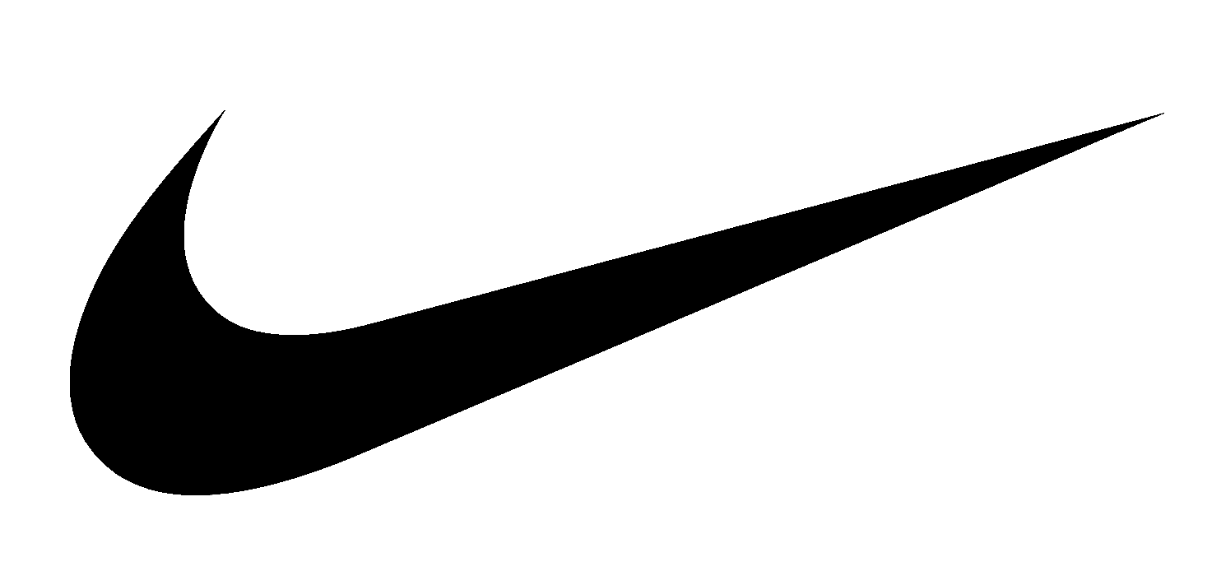
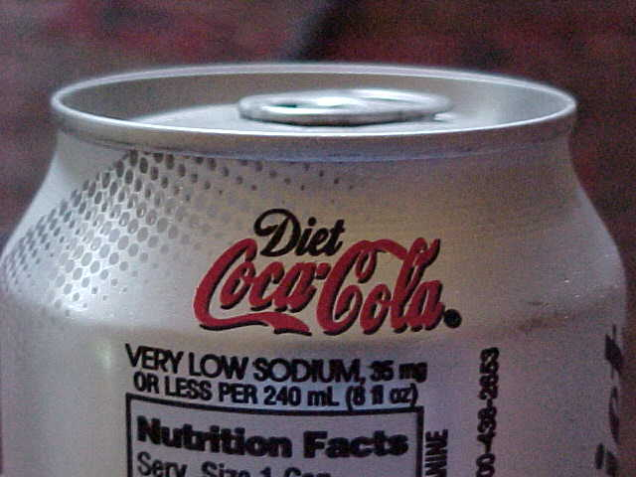
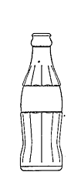
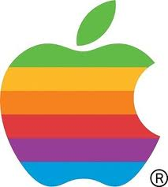
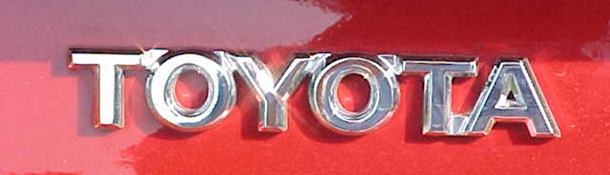
Any Word or Symbol
Smells, colors, sounds, too!
IBM
1-800-FLOWERS

Slide 17
Company and Product Branding In a Nutshell
Good branding answers the questions:
  Who am I?
  Where did I come from?
  Where do you look for me?
NOT:
  What am I?
  What do I do?
  What am I made of?
  Who are the customers buying me?

Slide 18
Strength of the Mark
Fanciful
Arbitrary
Suggestive
Descriptive
Generic terms
Strength
Distinctiveness

Slide 19
Strength of the Mark
XEROX
APPLE
COPPERTONE
1-800-FLOWERS
Aspirin
Strength

Slide 20
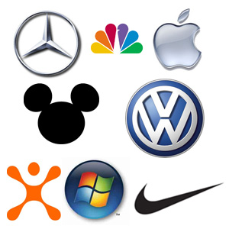
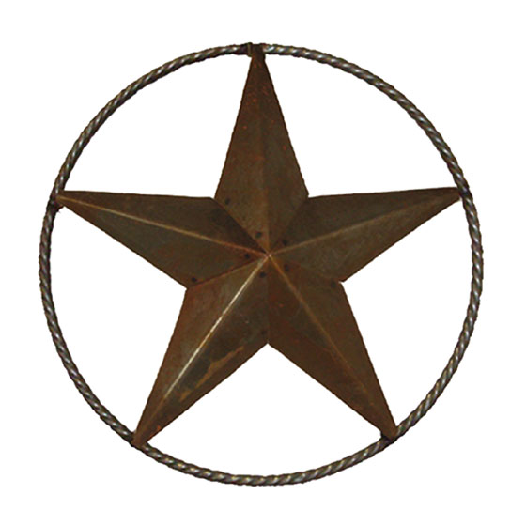


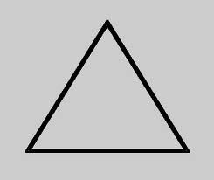
Distinctive Symbols
Distinctive: Not so much:

Slide 21
Slogans
JUST DO IT
DON'T LEAVE HOME WITHOUT IT
HAVE IT YOUR WAY
Should be short and punchy and not tell you exactly what the product is.
The sizzle … not the steak.

Slide 22
What You Get (or Don’t Get)
First user gets right to stop junior user of same/similar symbol for same/similar product or service
Does not give a monopoly over the type of product/service
Does not give a monopoly over the word or symbol
US rights are based on use, not on registration (but benefit from registering); other countries give rights based on registration

Slide 23
No Monopoly
DELTA faucets, DELTA Dental, DELTA Airlines
FORD Motors, FORD Model Agency

Slide 24
How to Choose Names
BRAINSTORM.
Focus on words, not symbols. How will phone be answered? What domains are needed?
Suggestive names are easily registered and marketed
Choose term from mythology, location, field of study:
  PANDORA music website
  AMAZON.COM retail services
Summarize your mission statement:
  AUDIBLE recorded books
Truncate or make up pronounceable acronym
  HIMARS for rocket system
Find an apt foreign term that is not descriptive when translated
Combine familiar terms in new ways – add colors, numbers

Slide 25
What Not to Choose
Misspelling of common term in your industry
A word ending in –ING (sounds like what you do and not who you are)
Highly descriptive or geographic terms:
  Turn-Key Solutions
  Capital Advisors
  New Jersey Financial Center
  BOOKS ON TAPE
These might be protectable but costs will be very high!

Slide 26
You Will Get A Letter (or Worse)
If you use or alter a famous mark
  Accountants-R-Us
  Mercedes symbol
… Even if you add something descriptive
  Nissan Computers
If someone thinks they own all possible uses
If they sue everyone in sight
If your mark is a misspelling of a commonly used term – KWIK = QUICK
Many of these are revealed in a full search

Slide 27
Company versus Product Name
Company name is not necessarily known to the public
Company name is not necessarily used as a trademark
Coca-cola Company versus COCA-COLA
Coca-cola Company also owns MINUTE MAID and other brands
Kellogg’s is buying PRINGLES brand chips

Slide 28
Company Names
Availability of business name (in Delaware or New Jersey) does not mean the name is available for use
Secretary of State may allow you to come very close to names of others
Availability of domain name does not mean the domain name is available for use
NO ONE CHECKS trademark rights against company name or domain name applications
Up to the applicant to do a search of prior rights

Slide 29
Before Investing in a Trademark or Name
Search – looking for:
  Similar, potentially blocking marks
  Third parties with credible claims of prior use
  Litigious third parties with similar marks
  “Commercial space” around a mark
  Third party common law rights
  Common use of the proposed mark in the industry

Slide 30
Sources for Search
Free:
  USPTO website
  Search engines
  Phone directory sites
  Domain registration sites
Paid:
  Vendor searches of TM registries, State / Provincial registrations, common law references, domain names and internet references

Slide 31

Everything Old is New Again

Slide 32
Company May Claim Use on Items
All clothing
gloves
jerseys
boots
sweatshirts
socks
Pullovers
Only used in the U.S. for:
hats, caps
shoes
t-shirts
dresses
skirts
overalls
anoraks
jackets
jeans
blouses
parkas
vests
pants

Slide 33
Scope of Protection
Unregistered marks protected by the Lanham Act and by State law – standard is LIKELIHOOD OF CONFUSION with mark or name of senior user
Scope of protection may exceed use or registration
Confusingly similar
Goods claimed

Slide 34
Shout Your Claims to the World
Apply to register your marks early!
This is the best public notice of a claim
Registration cannot be completed until the mark is in use
Use the TM or SM symbol early and often, ® after registration

Slide 35
“Use in Commerce”
Rights prior to actual use are very limited because there has been no market penetration.
For goods: the mark must appear on the goods, the container for the goods, or displays associated with the goods, and the goods must be sold or transported in commerce.
For services: the mark must be used or displayed in the sale or advertising of the services, and the services must be rendered in commerce.

Slide 36
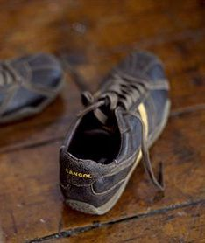
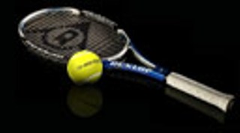
Samples of Use on Goods
DUNLOP® for tennis balls and tennis racquets
KANGOL® for shoes

Slide 37
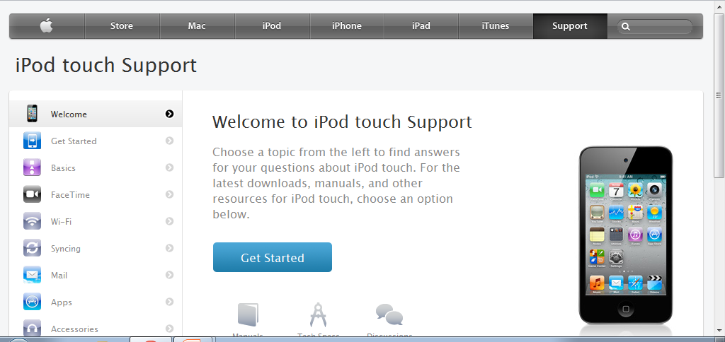
Sample of Use on Services

Slide 38
Is it Really in Use?
An item has to be in existence, not just on the drawing board, and actually sold or given to a stranger
Sale or transport is use, must be made in the course of ordinary trade (no token use)
Presentations and other preparations to sell don’t count as use, nor does fund-raising or press release usage
Presentations to investors are not USE
Beta testing or clinical trial is often use – must be put into hands of consumers

Slide 39
Appropriate Use of Trademarks
Trademarks are adjectives
Never use trademarks as nouns
Never use trademarks as verbs
Display mark in stylized font or bold, with appropriate trademark notice
Style and TM Usage Guides

Slide 40
Protecting Yourself Through Proper Usage
Don’t risk “genericide”
It took a lot of hard work and $$ for Xerox to get people to “Stop ‘xeroxing’ and start photocopying”
“Aspirin” is a generic term in the U.S.
You lose through tolerance of infringement

Slide 41




Slide 42


Trademark Notice
Use of the ® Symbol
Use of the ™ Symbol

Slide 43
US Registration Process – US Applicant
Identify mark and owner
Identify the goods / services – all of them
Is it in use on every item? Do we have a sample of use?
No, intend to use
Yes, have date of first use and sample
Examination,
publication
Examination,
publication
Allowance. File statement of use
with date of first use
and sample of use within 36 months
Registration

Slide 44
Process and Timing
Screening Search
US Registration in about 10 months if mark is in use
File statement of use
Publication for opposition in about 6 months
Application filing
Examination, respond to comments if any
If not in use, get allowance in about 10 months, up to five 6 month extensions of time to file statement of use
Registration
Full search if desired
Maintenance filing in 5 - 6 years
Renewal in 9 - 10 years
Claim priority for foreign applications 6 months after filing in USA

Slide 45
Opening Doors: Foreign Registration
Many jurisdictions require registration as prerequisite to protection
These are major potential markets for US companies
Many require registration of license agreements
There is no truly “international” registration but there is the Madrid Protocol

Slide 46
The Madrid “Spider”
PTO C
PTO B
PTO D
PTO A
Basic Application
PTO E
PTO H
PTO F
PTO G

Slide 47
ICELAND
RUSSIA
KAZAKHSTAN
MONGOLIA
GEORGIA
KYRGYZSTAN
UNITED STATES
TURKEY
TURKMENISTAN
MOROCCO
ISRAEL
UZBEKISTAN
CHINA
ALGERIA
IRAN
JAPAN
CUBA
EGYPT
KOREA
ANTIGUA & BARBUDA
OMAN
FRENCH GUIANA
SUDAN
BAHRAIN
BHUTAN
VIETNAM
SIERRA LEONE
GHANA
KENYA
LIBERIA
MOZAMBIQUE
SAO TOME AND PRINCIPE
MADAGASCAR
ZAMBIA
AUSTRALIA
NAMIBIA
BOTSWANA
LESOTHO
Madrid Protocol
Madrid Protocol and Madrid Agreement
Madrid Agreement
No Treaty
Notes:
46

Slide 48
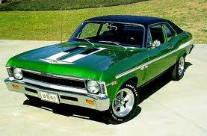
Joke’s On You!
NOVA not a superstar in Latin America

Slide 49
Trademark Enforcement
USPTO / TTAB Actions
Court Actions
Internet and Domain Names
Customs Enforcement
Licensing
Sponsorships and other items
Enforcement is REQUIRED – or you lose rights by tolerance

Slide 50
Proofs to be Offered
Information about use of the mark
  on what is it used?
  where is it used?
  how long has it been in use?
Information about sales
  volume
  revenue
  geography
Information about extent of advertising and/ or media references
Customer perception (declarations or survey)

Slide 51
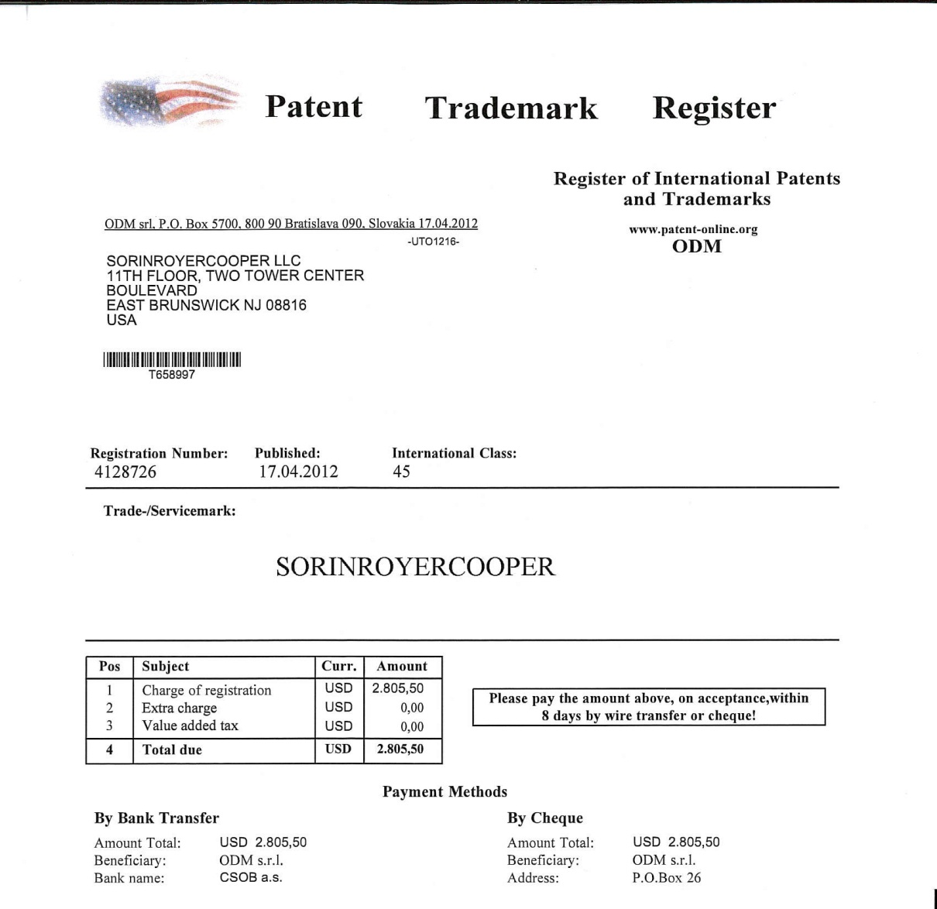
Watching and Being Watched

Slide 52
Trademark Enforcement: Domain Names
“These days we are dealing with it.”
Proactive domain name registration
  all proactively registered and acquired domains should be made “live”
  EXCEPT for .xxx – block it
Taking action against unauthorized registrants:
  Cease and desist letters
  UDRP actions
  Cybersquatting law suits

Slide 53
Watching Others
Free searches
Paid searches
  Trademark applications (US and/or foreign)
  Domain names
  Business names across states

Slide 54
Cybersquatting
Proof of cybersquatting requires:
  Bad faith registration of domain name
  Bad faith use of domain name
Complaining party must have PRIOR rights
Best to have registration certificates in hand
Possible actions include UDRP and court
Foreign is much more difficult unless fraudulent

Slide 55
If Someone Has Domain Name You Want
Defensive registrations are cheap but impossible to cover all bases
Is the one you want in use? How is it used?
When was it registered?
Possible to use anonymous purchase
Wait it out – backorder?
Negotiate with owner
Use a broker

Slide 56
Protection Through Licensing – Typical Terms
Licensed Products defined, grant limited, use limited
Royalties, reports and audit rights
Term and termination (sell-off period)
Quality Control – required!
Other IP rights (e.g. designs, derivative works)
Manufacturing and sample approval
Advertising and marketing approval
Insurance and indemnity

Slide 57
Marketing, Advertising and Promotion
Regulation is by FTC and States
Comparative advertising is commonplace in USA, forbidden elsewhere
Honesty about product and features is key
“Free” and “limited” offers subject to special scrutiny
Hot topic (getting colder): keywords or ad words on search engines (using TM to drive traffic to competitor)

Slide 58
QUESTIONS?
sgoldsmith@sorinroyercooper.com

